Slide 1
Semantic Policy Management for Tailored Data Sharing
DARPA Brandeis Program
August 2020
Contact
Ron Moore ronmoore@pacific-science.com
(858) 535-1661
Grit Denker grit.denker@sri.com
Karen Myers karen.myers@sri.com
Mark St. John markst.john@pacific-science.com
Approved for Public Release, Distribution Unlimited.
This research was developed with funding from the Defense Advanced Research Projects Agency (DARPA). The views, opinions and/or findings expressed are those of the author and should not be interpreted as representing the official views or policies of the Department of Defense or the U.S. Government.

Slide 2
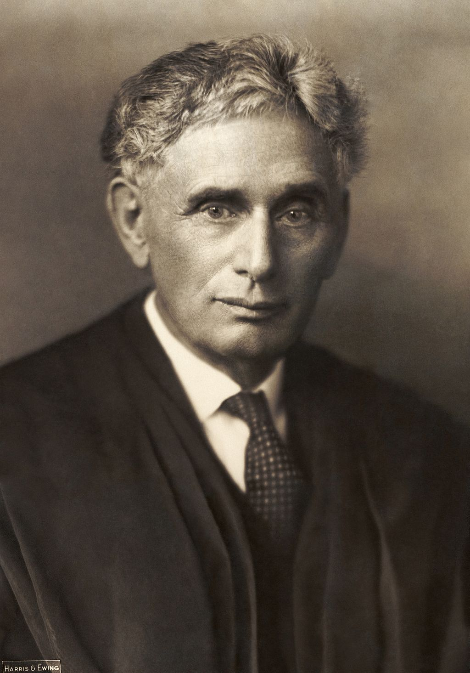
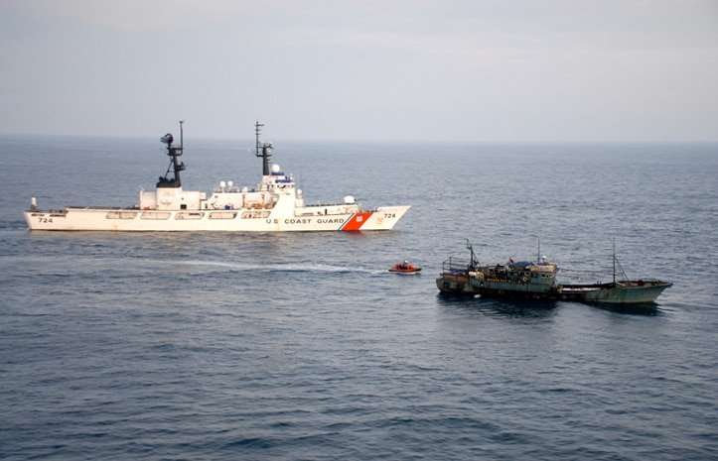


Semantic Policy Management for Tailored Data Sharing
Justice Louis Brandeis
Advocate for Privacy
Brandeis allows enterprise-level users to quickly and easily tailor data sharing to meet objectives without overexposing their private data
Problem
  Enterprises have many different types of data, some very sensitive
  Yet they want to share some date with some partners but not share with others
  “One-off” data sharing, “here’s the file,” does not work for long term objectives – too manual and too error prone
  Typical “access control” requires sophisticated DBAs to create and maintain, adding time, money, and obscuring oversight
Brandeis solution
  Brandeis is an emerging technology funded by DARPA to support sophisticated, yet easy to create and monitor, enterprise and multi-national data sharing
  Reap the benefits of data sharing without losing privacy and control
Notes:
Images found at
Louis Brandeis: https://en.wikipedia.org/wiki/Louis_Brandeis
Fishing enforcement: https://www.state.gov/key-topics-office-of-marine-conservation/illegal-unreported-and-unregulated-fishing/
Humanitarian relief: https://cco.ndu.edu/Media/Images/igphoto/2001676164/
MH-370: https://phys.org/news/2019-01-mh370-underwater-analysis-alternative-route.html

Slide 3
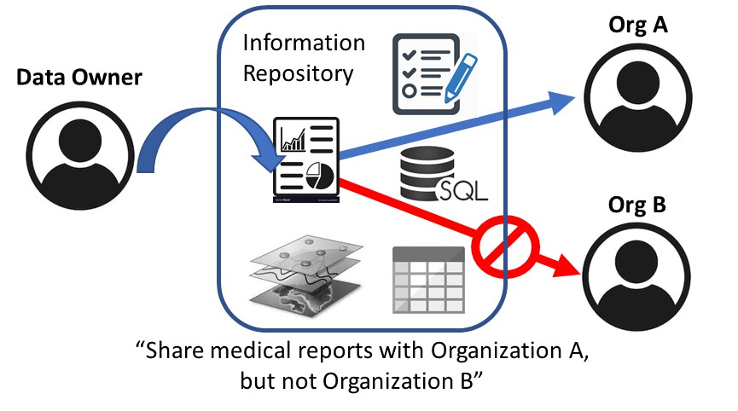
Semantic Policy Management: Benefits
Policies are defined/managed by data owners - doesn’t require system admin or technical expertise
Can easily change data sharing policies as the situation warrants and understand the impact
Enhances confidence and clarity of what is shared with whom
Increased control over who sees which data encourages more sharing

Slide 4
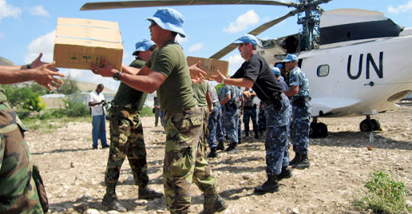
Three Real-World Examples of Multi-national Data Sharing Challenges
Multi-national law enforcement. Nations who may not trust one another entirely may be hesitant to share information widely
  Example: information about drug smuggling, piracy, and fisheries enforcement in high-traffic, low enforcement regions
Multi-national disaster relief operations. Nations may be hesitant to widely share their own asset capabilities and status information in order to coordinate disaster relief responses
Search for MH-370. Participants in multi-national operations have sometimes had to resort to work-around technologies in order to share desired information with specific parties
The most sensitive/useful data is often not shared using current technology; instead, inefficient work-arounds are used, or information simply isn’t shared.
- From a 2013-2014 DARPA study on the challenges to information sharing faced by coalitions/multi-national groups

Slide 5
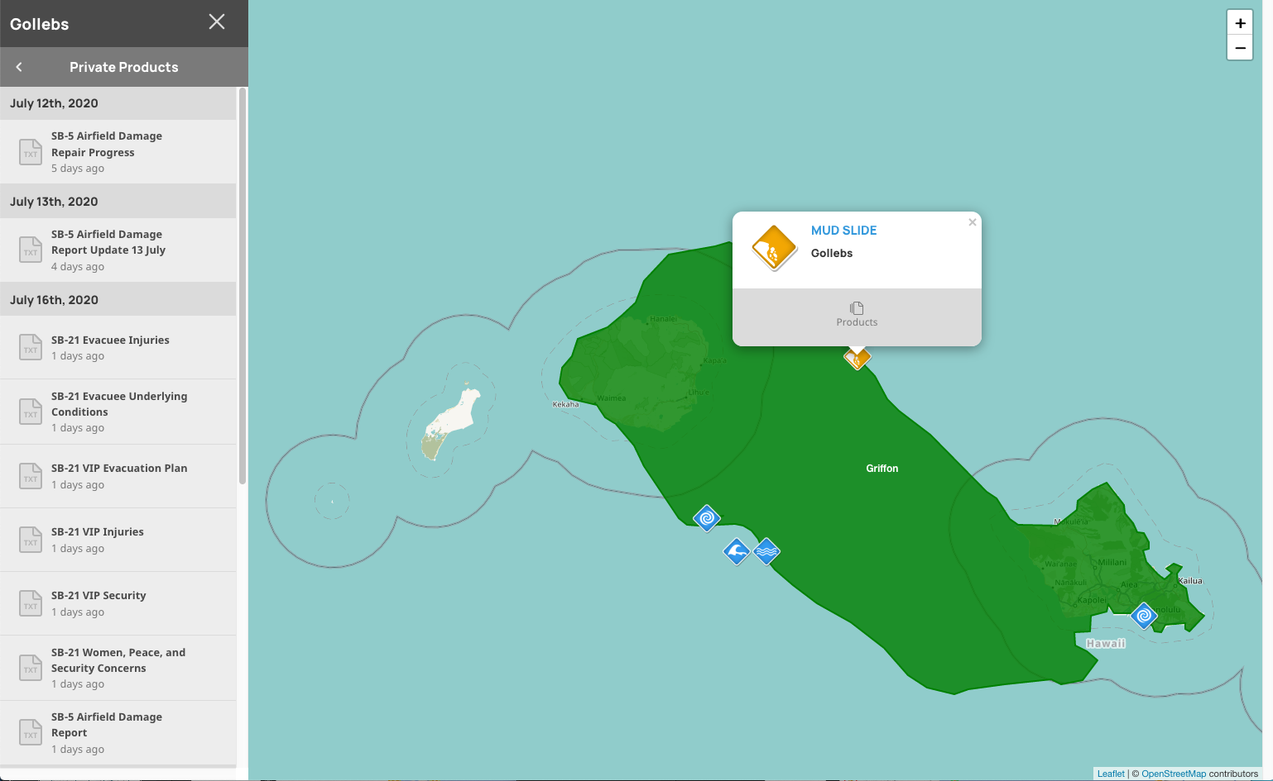
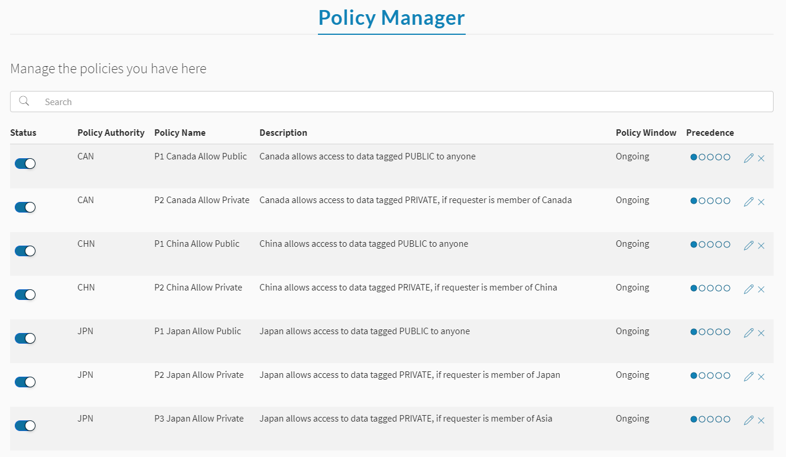
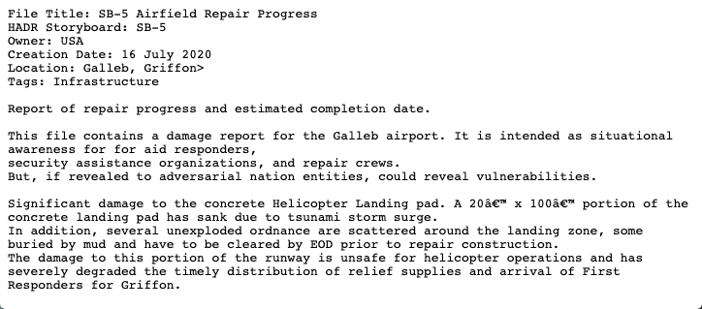
DARPA Brandeis Policy Management Technology
General, extensible framework for defining and enforcing information-sharing policies
Designed to enable data owners to easily tailor data access to meet dynamic sharing needs
Based on semantic models of information and users – not simple access/permissions
Modular add-on capability for an existing information system
Information Repository
Brandeis
Policy System
Information
Repository UI
Brandeis Policy UI
Example: During a pandemic, share residents’ names, locations, and disease status with local care providers and contact tracers, but only share counts of disease status by zip code with national epidemiologists

Slide 6
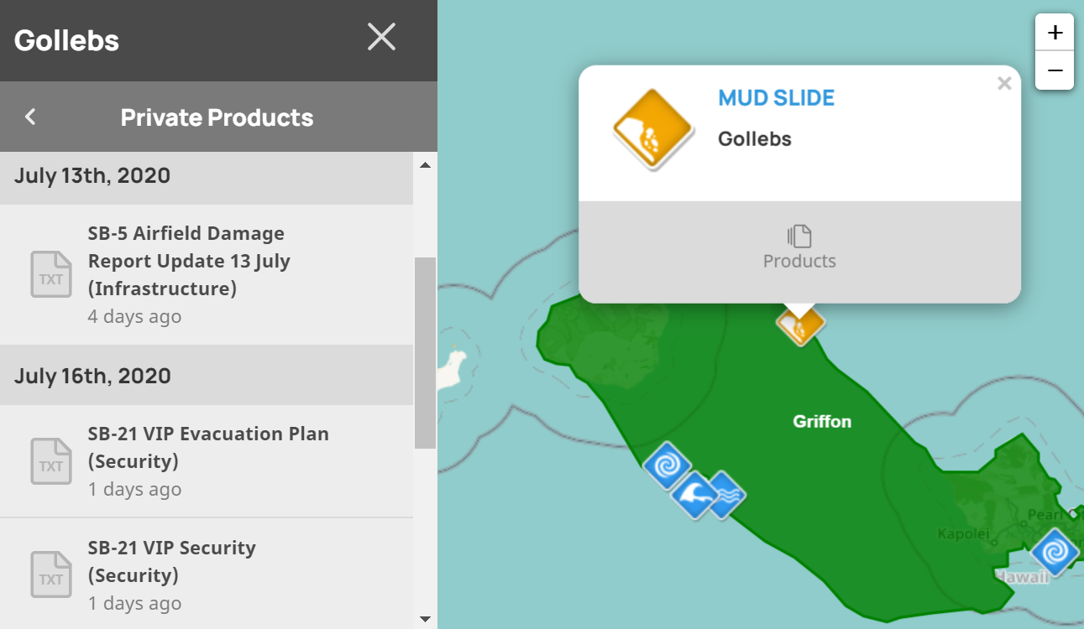
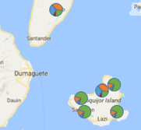
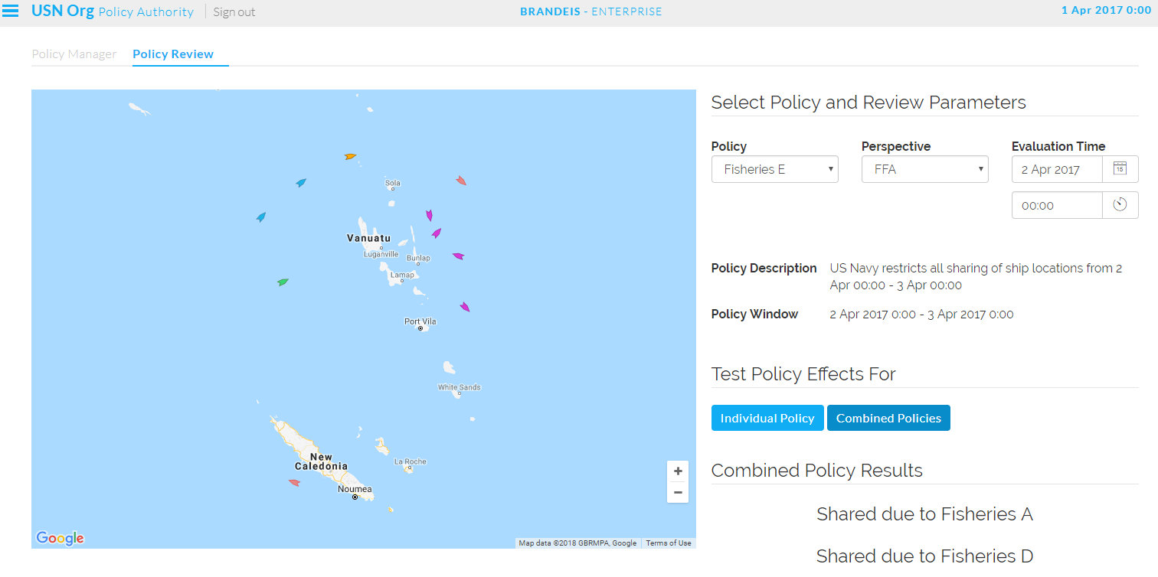
Brandeis Works with Many Types of Data and Systems
HADR Planning Documents
Data could include
  Database data types – which data types to join together and to share as a joined table
  Documents – Reports, briefs, spreadsheets, images
  Layers and data feeds
Systems
  Databases
  Document repositories
  Common Operating Pictures
Pandemic Case Data
Suspect Vessel Tracks
Notes:
Suspect vessel tracks image found at: https://www.marinetraffic.com/en/ais/home/centerx:-12.0/centery:25.0/zoom:4

Slide 7
Bottom Line
Brandeis was planned to be
  Demonstrated and evaluated during RIMPAC 2020
    Largest naval exercise in the world, 32 nations participating
    Use Brandeis to share information in support of multiple disaster relief missions
  Transitioned to the Pacific Disaster Center
    Their DisasterAware system shares disaster planning and relief information world-wide
  RIMPAC disaster relief exercises were cancelled due to Covid-19
Where we are now
  Looking for partners who are interested in Brandeis capabilities and technology and are interested in exploring “what it would take” to transition Brandeis to your systems
  What are your data sharing needs?

Slide 8
Brandeis
Value Proposition
Gain Creators
  Human- and Machine-readable data sharing policies
  Sophisticated, expressive policies
  Easy to specify and monitor UI, designed for end-users, not IT experts
Pains
  Tailored access control is primitive and potentially error-prone
  Or it requires a sophisticated, expensive DBA to maintain
  Hard to modify as situations change
  Lack of insight and difficult to QA
Gains
  Dynamic, tailored sharing to fit the situation
  Quick and easy control of data sharing
  Insight and oversight of all data sharing

Slide 9
Ideal Customer
Enterprises with complex data sharing requirements – tailored sharing with multiple partners
Enterprises desiring to give end-users the ability to define sharing
Enterprises interested in adapting our cutting-edge concepts to their systems, or
Enterprises simply interested in sharing their needs as a data point

Slide 10
Competitive Landscape: Role-Based Access Control Policies
XACML, SecPAL, and Ponder
  Requires exact matches between policy objects and requested objects, resulting in very many similar policies – difficult to write, difficult to understand, difficult to maintain
EPAL
  Provides category labels (such as share “location data”) which reduces the number of policies, but does not provide fined-grained tailoring of access control
KAoS, Rei, and AIR
  Powerful and expressive languages, but expressed in complex logical expressions and precise semantics which requires specialized training to create and understand
Brandeis
  Uses data models and shareability theory to provide an expressive, generalizable policy framework with an intuitive, graphical user interface. Underlying formalisms are hidden.

Slide 11
General Information System Architecture
Like XACML, a distinction is made between a Policy Enforcement Point (PEP) and a Policy Decision Point (PDP)
  Requests enter at the PEP. The requests are then sent to the PDP for evaluation, and a decision is returned to the PEP
  This approach ensures that the PDP needs no access to the data. The PEP makes decisions on the basis of policies. Only the PEP needs access to data in order to enforce constraints on which data are shared. This design increases data privacy
  Policies are created at a Policy Administration Point, also with no access to the data

Slide 12
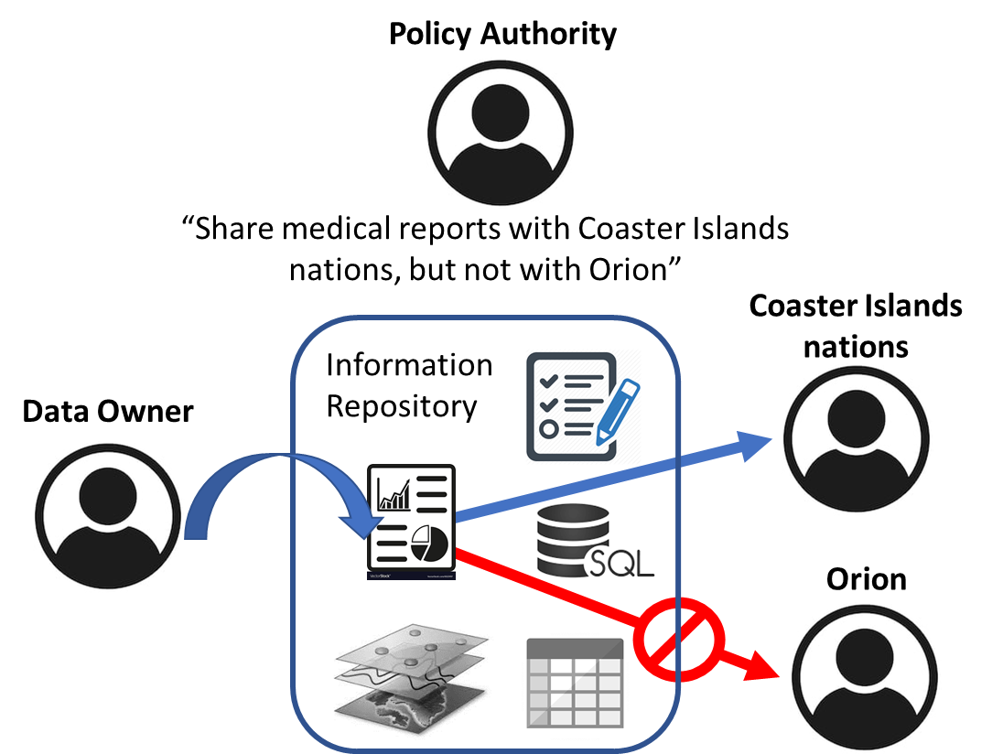
Concept of Operations
Data Owners upload data to an Information Repository (centralized or federated) with heterogeneous content
  Reports, database data, map layers, etc.
Policy Authorities create and modify data sharing policies
  Specify sharing of their organization’s data with different Data Requesters
  There may be one generic Data Owner role and one generic policy authority role per organization, or there may be finer structure within an organization
Data Requesters seek access to data in the Information Repository
  Requests are serviced in accord with current policies

Slide 13
Policy Management Elements
Enables fine-grain control over the release of private data
Policy Definition
Policy Reasoning
Policy Enforcement
Semantic models enable succinct policies that cover broad sets of situations
Policies are defined independent of specific requests or data elements
Intuitive, wizard-based specification of policies
Resolves conflicts through customizable override criteria (e.g., priorities, organizational structures)
Explains rationale for policy decisions
Determines post-processing steps for data to ensure policy adherence
Modular integration via simple APIs

Slide 14
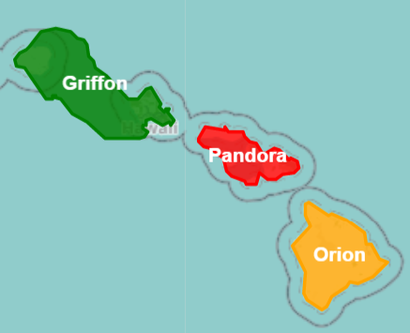

Demonstration Use Case: Mass Evacuation
Imagine a typhoon has struck the island nation of Pandora and trapped a community behind massive mudslides. Casualties need evacuation.
As a default Pandora denies sharing their data and has set a baseline policy to that effect
Pandora decides to override this policy and share sensitive medical information about the evacuees with the other nations of the Coaster Islands
  No other groups should see this information
However, recent poor relations with Orion have led Pandora to deny any data sharing with Orion
Bottom line: Brandeis policy management provides sophisticated, user-friendly methods for enabling the desired data sharing
Deny all (precedence 0)
Pandora’s data-sharing policies
Share medical information with all nations of the Coaster Islands (precedence 1)
Deny all sharing with Orion (precedence 2)

Slide 15
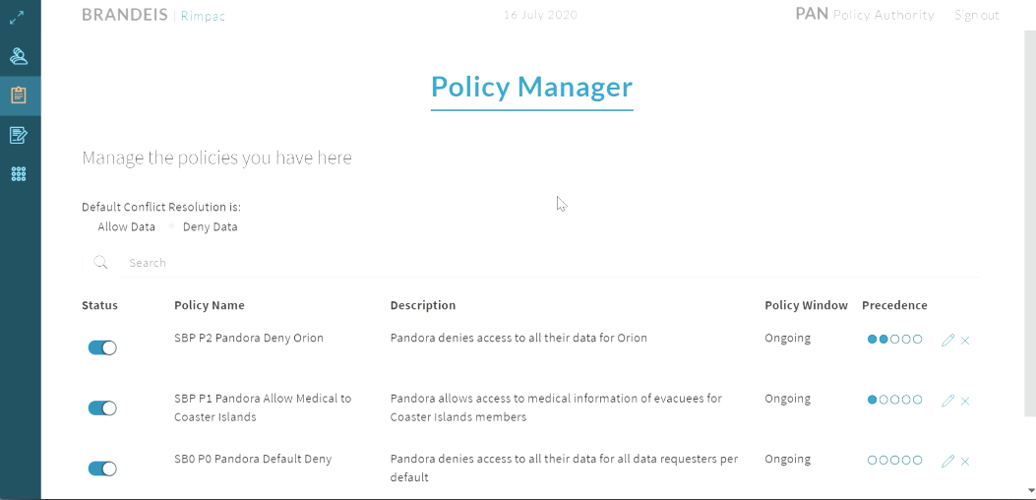
Demonstration: Watch the short demonstration of creating a data sharing policy
Policy Management Demo
https://www.pacific-science.com/Brandeis/Brandeis_UI_movie.mp4

Slide 16
Additional Technical Detail

Slide 17
Privacy Policy Specifications
Policies specify which data is shared (or not) with whom and under what circumstances
Data requests are checked against all existing policies
If multiple policies match, overriding criteria are used to determine final result
Sharing Decision includes additional information such as policy responsible for decision, applicable constraints and so on
Sharing Decision
Policy Authority
Allow/Deny
Policy ID
Policy Description
Expiration
[Constraints]
Policy
Policy Authority
Allow/Deny
ID
Description
Priority
Requesters
Data
[Constraints]
[Start Time]
[End Time]
Request
Who? (Requester)
What? (Data)
When? (Request time)
Overriding Criteria
Decisions with higher authority/priority override decisions with lower authority/priority
Notes:
I wouldn’t call this language, this seems odd if we only give lists of parameters (and even more odd if we talked about an expressive language on the next slide)

Slide 18
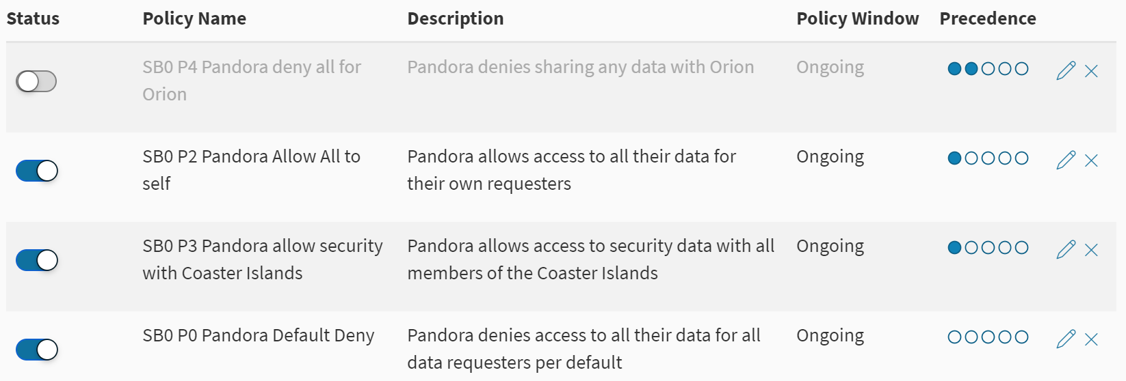
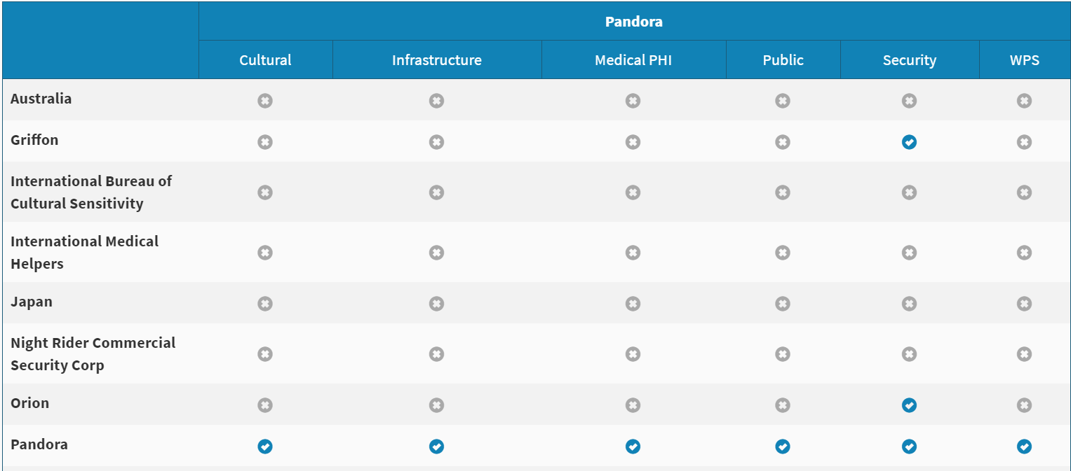
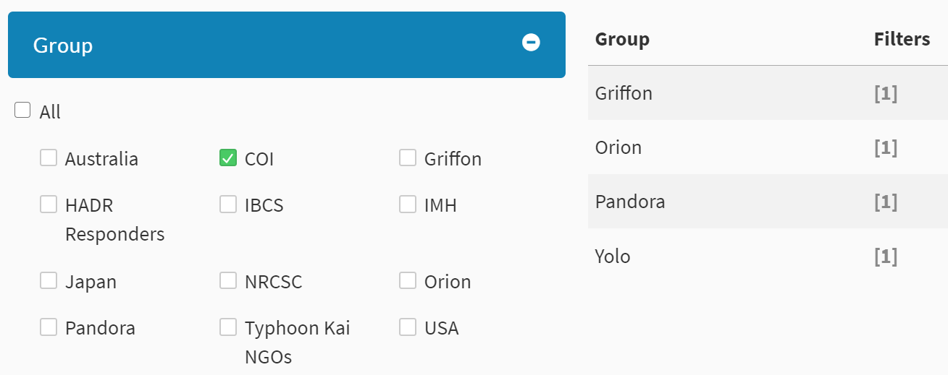
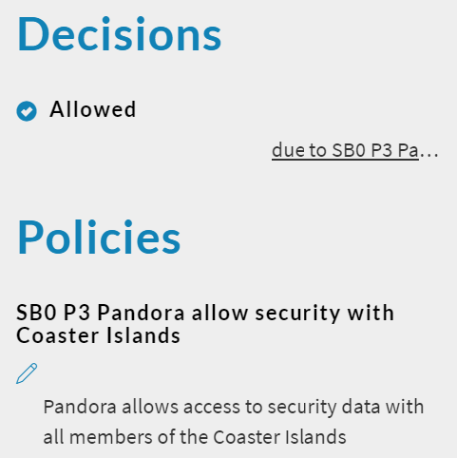
Brandeis Policy Management is Highly Usable
Policy Manager
Provides a listing of all data sharing policies
Access Review Matrix
Provides a matrix of decisions for each combination of data tag and requester
Policy Creation
Four-step software wizard use point and click; no complex database expressions
Decision Explanations
Provides a listing of policies that affected

Slide 19
Software Architecture
Information System
Brandeis Policy-Based Information Sharing System
Information Application
Data & Policy
Check
Brandeis Policy Enforcement
Brandeis Policy Reasoner
(Machine-readable) Policy Definitions
Brandeis Policy Manager
(Human-readable) Policy
Definitions
Data
Request
Policy
Decisions
Data
Requester
Policy-Safe
Data
Policy Enforcement Point
Apply policy decisions to specific data and requester combinations
Policy Decision Point
Reason over applicable policies to determine access for each owner/requester group combination
Policy Administration Point
Easy-to-use policy management user interface to define complex policies
Data
Load
Information Repository
Data
Owner
Policy
Authority
Data-dependent operations
Data-independent operations

